Slide 1
SERVICE LEADERSHIP
WELCOME
Prepared by David Schieler (he/him/his)

Slide 2
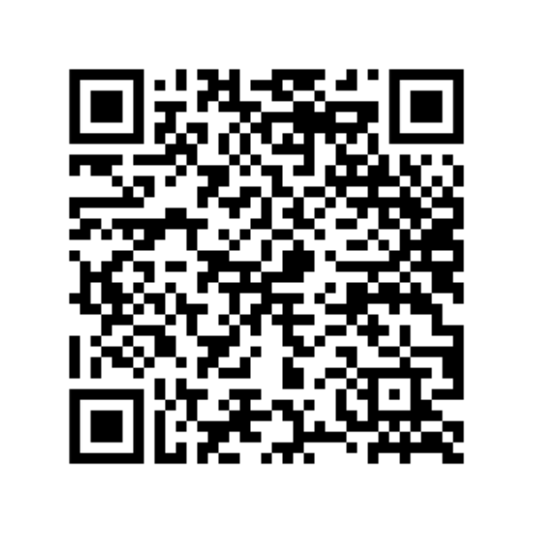
TODAY'S
PRESENTATION
ABOUT ME
An introduction to the identities and experiences which inform my practice.
SERVICE LEADERSHIP
An overview of my approach to a service leadership preparatory workshop for first-year students.
QUESTIONS & DISCUSSION
A dialogue intended to generate further thought and deeper community.

Slide 3

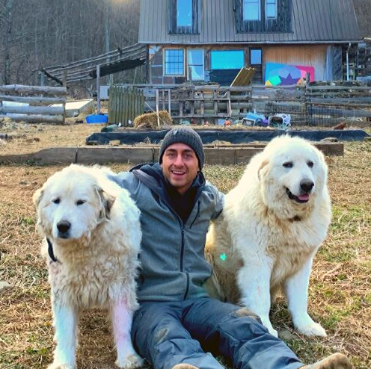
DAVID SCHIELER
IDENTITY
EXPERIENCE

Slide 4
THE PROMPT
HOW WOULD YOU APPROACH AN EDUCATIONAL WORKSHOP FOR A GROUP OF DEMOGRAPHICALLY DIVERSE, FIRST-YEAR STUDENTS TO PREPARE THEM TO CONDUCT SERVICE IN THE COMMUNITY?

Slide 5
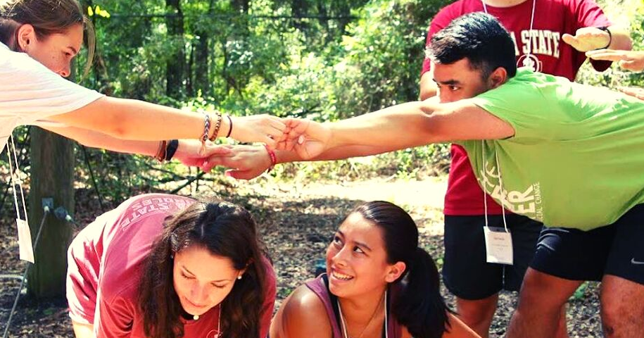
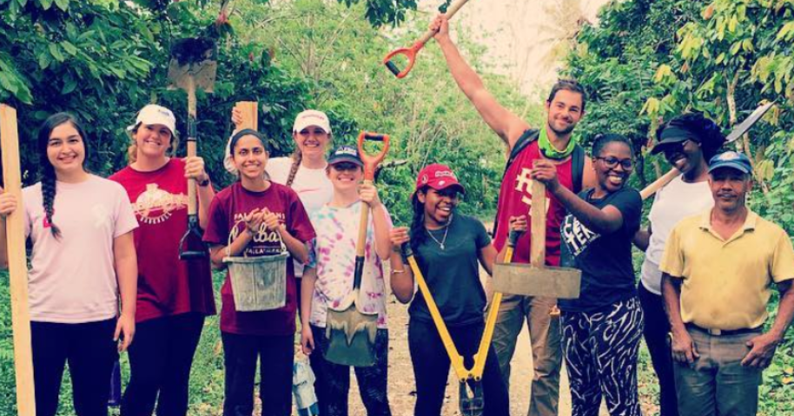
LEADERSHIP
"...leadership is a process forged by our identities, values and experiences."
2017 Florida State Alternative Break
2018 Service Leadership Seminar
SERVICE
"...service is an effective way to learn about yourself and others."

Slide 6
TENSIONS IN SERVICE RELATIONSHIPS
"A PROBLEM WELL-STATED IS HALF SOLVED" - CHARLES KETTERING
LEARNING VS. EFFICIENCY
IDEALISM VS. REALISM
Perception of meaningfulness.
Transformative or stepwise change.
HOURS VS. COMMITMENT
FLEXIBILITY VS. DEPENDABILITY
Longevity and motivation for service.
Prioritization of commitments.
(Mills, 2012)

Slide 7
TENSIONS IN SERVICE RELATIONSHIPS
"A PROBLEM WELL-STATED IS HALF SOLVED" - CHARLES KETTERING
LEARNING VS. EFFICIENCY
IDEALISM VS. REALISM
Perception of meaningfulness.
Transformative or stepwise change.
HOURS VS. COMMITMENT
FLEXIBILITY VS. DEPENDABILITY
TENSION REFRAMED
Longevity and motivation for service.
Prioritization of commitments.
Generate commitment over time.
(Mills, 2012)

Slide 8
TENSIONS IN SERVICE RELATIONSHIPS
"A PROBLEM WELL-STATED IS HALF SOLVED" - CHARLES KETTERING
LEARNING VS. EFFICIENCY
TENSION REFRAMED
IDEALISM VS. REALISM
Approach to service actions.
Find meaning in low-skilled tasks.
Transformative or stepwise change.
HOURS VS. COMMITMENT
FLEXIBILITY VS. DEPENDABILITY
TENSION REFRAMED
Longevity and motivation for service.
Prioritization of commitments.
Generate commitment over time.
(Mills, 2012)

Slide 9
TENSIONS IN SERVICE RELATIONSHIPS
"A PROBLEM WELL-STATED IS HALF SOLVED" - CHARLES KETTERING
LEARNING VS. EFFICIENCY
TENSION REFRAMED
IDEALISM VS. REALISM
Approach to service actions.
Find meaning in low-skilled tasks.
Transformative or stepwise change.
HOURS VS. COMMITMENT
FLEXIBILITY VS. DEPENDABILITY
TENSION REFRAMED
TENSION REFRAMED
Longevity and motivation for service.
Prioritization of commitments.
Generate commitment over time.
Instill a sense of usefullness
(Mills, 2012)

Slide 10
TENSIONS IN SERVICE RELATIONSHIPS
"A PROBLEM WELL-STATED IS HALF SOLVED" - CHARLES KETTERING
LEARNING VS. EFFICIENCY
TENSION REFRAMED
TENSION REFRAMED
IDEALISM VS. REALISM
Approach to service actions.
Find meaning in low-skilled tasks.
Challenge false and dualistic dichotomies.
Transformative or stepwise change.
HOURS VS. COMMITMENT
FLEXIBILITY VS. DEPENDABILITY
TENSION REFRAMED
TENSION REFRAMED
Longevity and motivation for service.
Prioritization of commitments.
Generate commitment over time.
Instill a sense of usefullness
(Mills, 2012)

Slide 11



BECOMING CULTURALLY RELEVANT
PREPARING FOR CRITICAL SERVICE
Contextual
Reciprocal
Conscious of Power & Privilege
(Wagner & Pigza, 2016)

Slide 12



BECOMING CULTURALLY RELEVANT
PREPARING FOR CRITICAL SERVICE
Reflective
Sustainable
Socially Just
(Wagner & Pigza, 2016)

Slide 13
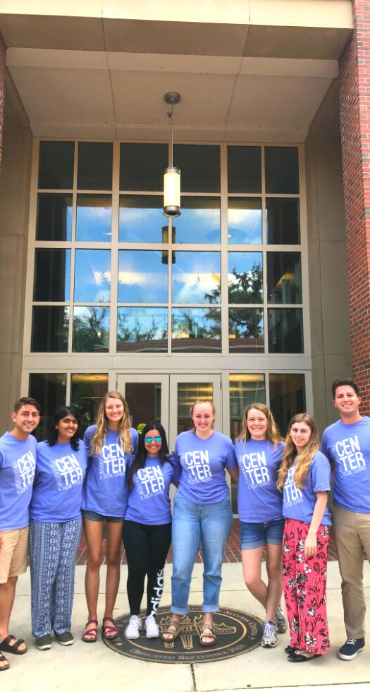
PUTTING IT TOGETHER
PREPARING TO BE IN COMMUNITY
KNOW & LOVE YOURSELF
Acknowledge your motivations and desires for service. Recognize your position in relation to the issue(s).
KNOW & LOVE OTHERS
Interrogate root causes (often systemic oppression) and work reciprocally with community assets to create sustainable social change.

Slide 14
THE PROMPT
HOW WOULD YOU APPROACH AN EDUCATIONAL WORKSHOP FOR A GROUP OF DEMOGRAPHICALLY DIVERSE, FIRST-YEAR STUDENTS TO PREPARE THEM TO CONDUCT SERVICE IN THE COMMUNITY?

Slide 15
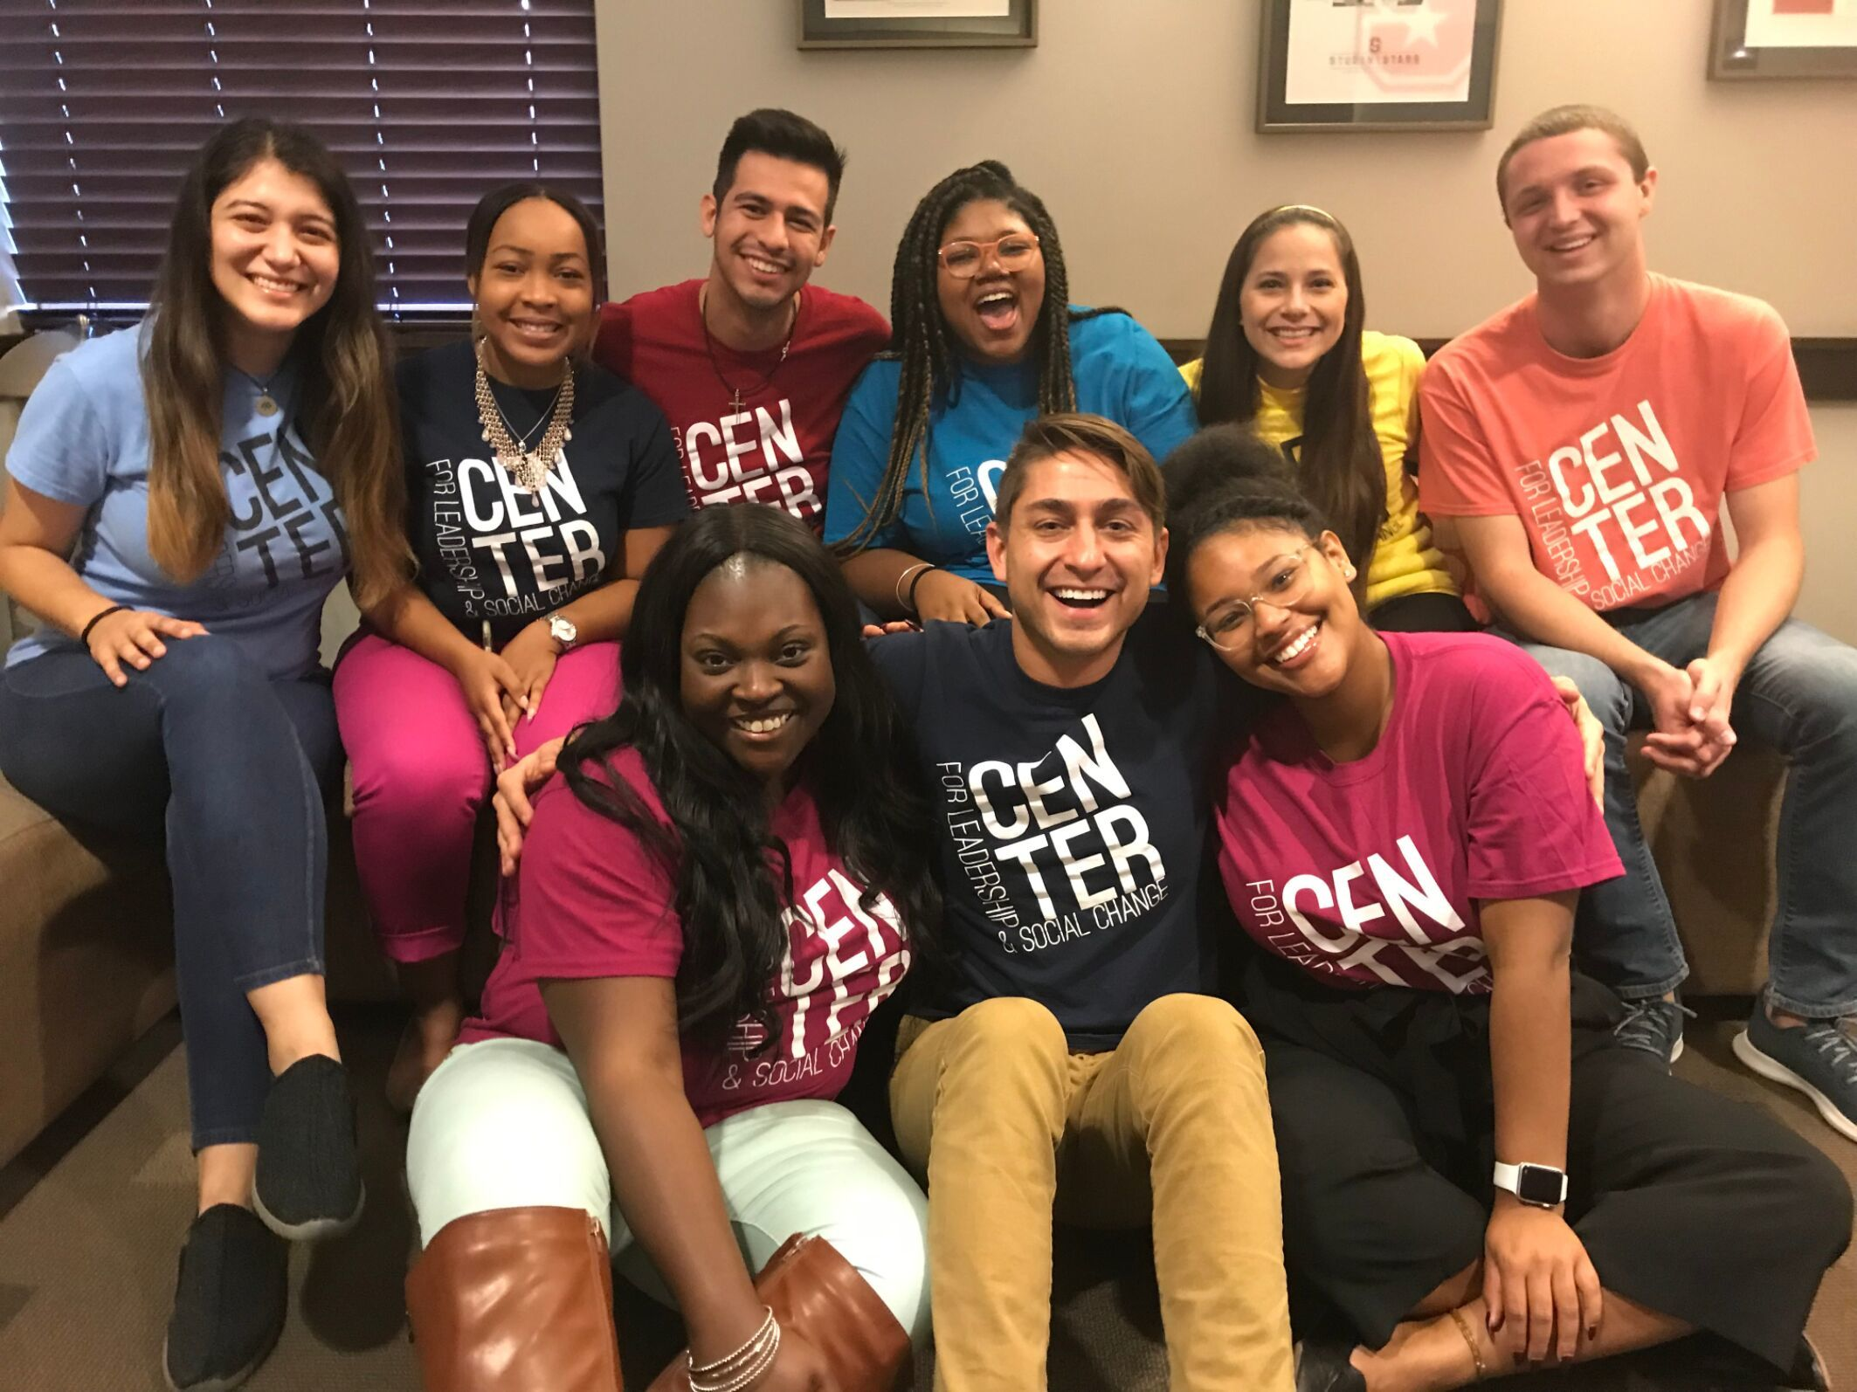
"There's no separation between self and other, and everything is interconnected."
THICH NHAT HANH

Slide 16
CONTINUING THE CONVERSATION
THANK YOU

